Slide 1
Constructs of self and other
Considerations for interpreters
Tom Humphries
University of California, San Diego

Slide 2
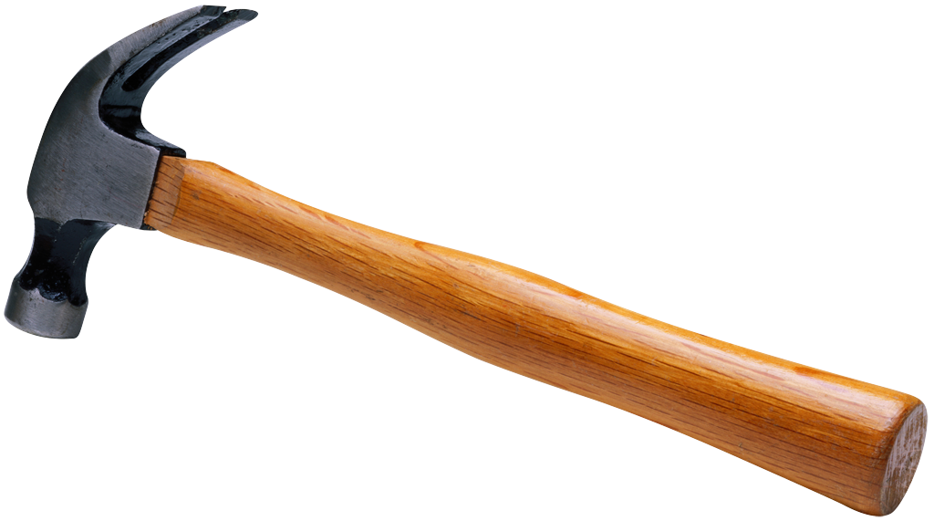
Culture as “a world of meaning”
Cultural processes produce different “worlds”.
It’s what we do.
We construct ourselves.
And others.

Slide 3
The evidence of languages
ASL
English
DEAF
HEARINGEARING
deaf
Ø
self other other self

Slide 4
These constructs are models.
They are abstractions.
They make translations across meaning systems (using language) problematic.
They constrain ability to “know” the other.

Slide 5
When cultures interact meaning must be negotiated.
Example of the American Heritage dictionary definition of audism:
Original definition: “Discrimination or prejudice against people based on the fact that their ability to hear is impaired or absent”.

Slide 6
Problem: only half the story, treats deafness as a biological construct.
This an Ø construct, represents one group’s construction of the other.
Normativity bias. (Example of ‘tan’)
Notes:
Becomes brown with exposure to the sun.
Becomes darker with exposure to the sun.

Slide 7
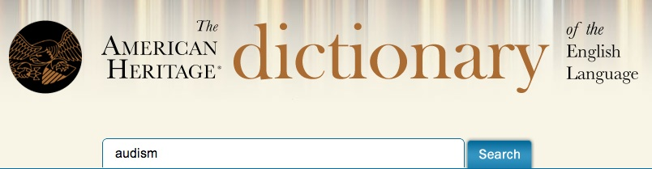
New definition as of December,2012
The belief that people with hearing are superior to those who are deaf or hard of hearing.
Discrimination or prejudice against people who are deaf or hard of hearing.
Notes:
Word may have different meaning across deaf cultures, meaning is still being made.

Slide 8
Meaning is defined in relation to other concepts and usage within the same culture.
Working across two cultures is a process of finding existing meaning in the culture in question.
Context is everything.

Slide 9
Thank you!

